Slide 1



Notice
Warning
Collection
new song Arrived
If you feel dizzy, stop playing the game
Now Play
If you continue to feel dizzy,
visit a hospital or doctor.
POP/stars – K/DA
replay
PLAY
Credit

Slide 2

Mode Select
competion
mode
Solo PLAY
mode
Team play
mode
Compete with other players
in performance
Play Wotagei Alone
Play Wotagei with Other Players

Slide 3
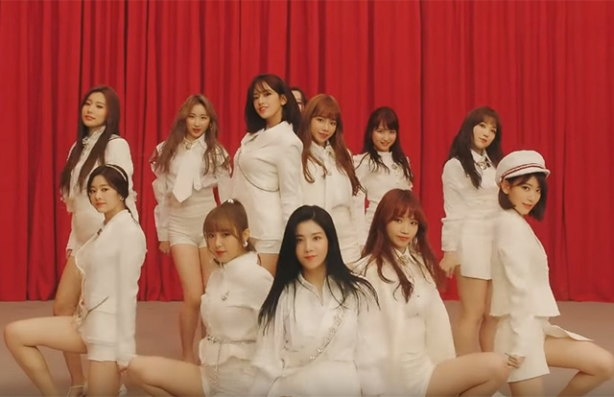





Music Select
Ddu-du-ddu-du
Global Ranking
My records
blackpink
ranking
username
score
pop/stars
date
score
rank
1
2
3
4
5
6
Nickname
Nickname
Nickname
Nickname
Nickname
nickname
000000
000000
000000
000000
000000
000000
k/da
2019/03/20
2019/03/20
2019/03/20
2019/03/20
2019/03/20
2019/03/20
000000
000000
000000
000000
000000
000000
SS
Ss
Ss
Ss
Ss
Ss
LA vie en rose
IZ*ONE
La vie en rose
Iz*one
Yes or yes
normal
HARD
twice
GAME STArt
Fake love
Click this button to play
bts

Slide 4
c b a s
000000
0 X
SPIN!

Slide 5
c b a s
000000
0 X

Slide 6
c b a s
000000
0 X

Slide 7
c b a s
000000
0 X
SPIN!

Slide 8
c b a s
000000
0 X

Slide 9
c b a s
000000
0 X

Slide 10
c b a s
000000
0 X

Slide 11
Collectin
Game Result
A
Global Ranking
My records
ranking
username
score
date
score
rank
1
2
3
4
5
6
Nickname
Nickname
Nickname
Nickname
Nickname
nickname
000000
000000
000000
000000
000000
000000
2019/03/20
2019/03/20
2019/03/20
2019/03/20
2019/03/20
2019/03/20
000000
000000
000000
000000
000000
000000
SS
Ss
Ss
Ss
Ss
Ss
La vie en rose
rank
Iz*one
normal
HARD
Score 000,000
Best score 000,000
Go to music select
Combo 000x
REtry
Best Combo 000x

